Slide 1
Welcome!
Question of the Day:
What do you like better in a Super Bowl: football, commercials or half-time show?
‹#›

Slide 2
4.1 if/else Statements
CAROL RAMSEY
GDC 6.318
ramsey@cs.utexas.edu
Notes:
need clicker checks

Slide 3
Announcements - Unit 1 Test
Grades are posted.
You will get your Exam back in Section today.
Test Average: 71
Learn from your Exam.
Fill in gaps in content knowledge.
Fill in gaps in study habits.
More info on Wednesday about this.

Slide 4
Announcements - Grading Adjustments
Adjustments are very rare.
Rubrics are reviewed and verified.
Only adjustments are for when there was a mistake in applying the rubric.
If you think there is a mistake, you must:
Notify the TA before you leave Section.
Return your test to the TA.
Email the TA during Section with a photo of the issue and why you think the rubric was applied incorrectly.
The TA will evaluate the request at a later time and send you an update.

Slide 5
CS 312 “We Got This!”

Slide 6
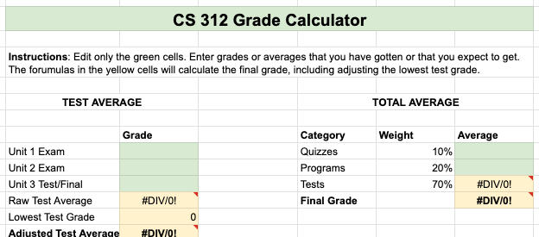
Grade Calculator
Link in Canvas.

Slide 7
Quizzes return on Wednesday

Slide 8
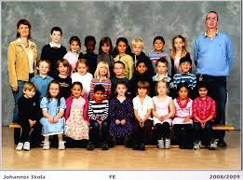
Class Photo

Slide 9
One More Thing

Slide 10
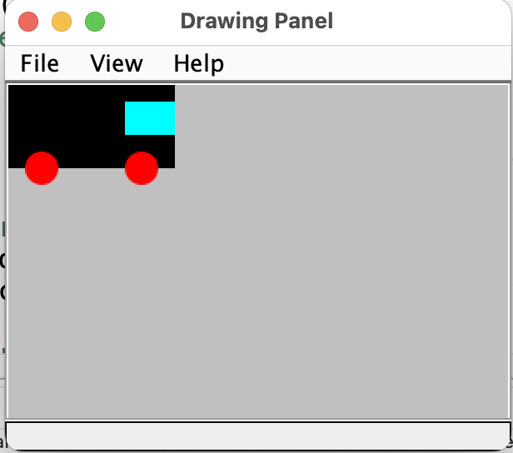
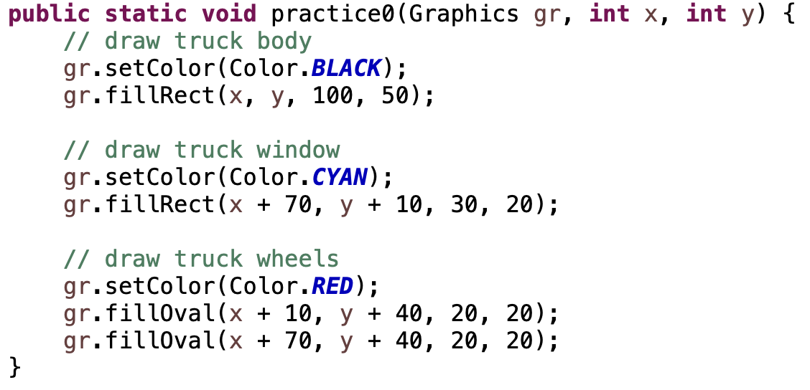
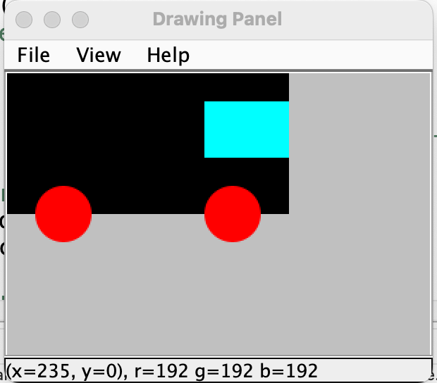
In-Class Practice
Review this method that draws a truck at a particular location. Make edits to the method to allow for a truck of a particular size. Have size refer to the diameter of the wheels.
Hint: You will need to get rid of magic numbers first.

Slide 11
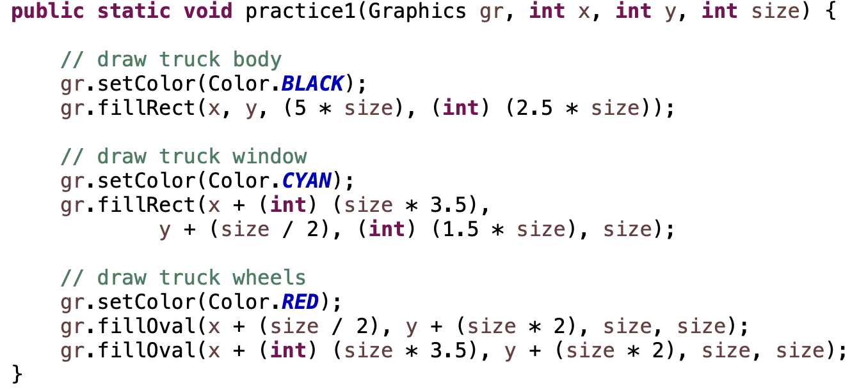
Solution

Slide 12
4.1
if else Statements
Notes:
Session Title: Project Based Learning (PBL) for Equity in CS classes
Session Description: If you are teaching a survey course like Computer Science Principles, or a code intensive course like AP CS A, PBL can serve as a powerful tool to increase student interest and engagement. Learn about research that connects PBL to improved student outcomes, especially for girls and underrepresented minorities. Discover available PBL resources and understand PBL lesson components, so you can build your own.

Slide 13
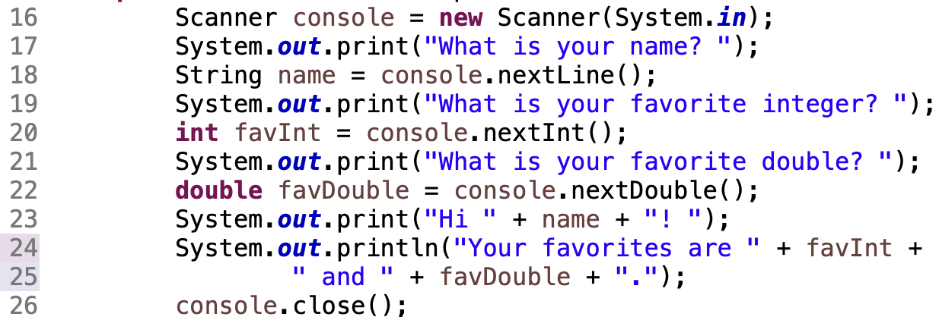
It’s a Mystery

Slide 14
System Object
interactive program: Reads input from the console.
Scanner: An object that can read input from many sources (keyboard, files, databases, etc.).
‹#›

Slide 15
Creating a Scanner
To create a scanner object:
Similar to creating a Drawing Panel object:
Also need to import util.Scanner:

Slide 16
Java Class Reference - Scanner

Slide 17
Demo
Demo1()
Entering data in the console
What could go wrong?

Slide 18
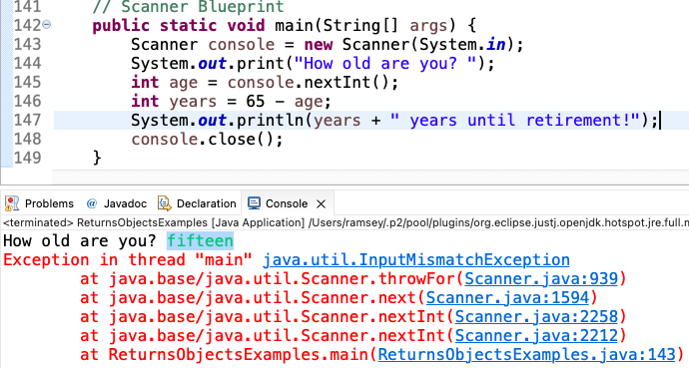
Beware of the User
‹#›

Slide 19
Demo
Demo2()
What else is new?

Slide 20
The If Else Statement

Slide 21
Before we go further, we must talk about…

Slide 22
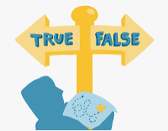
Boolean Expressions
if statements and for loops both use logical tests.
for (int i = 1; i <= 10; i++) { ...
if (i <= 10) { ...
These are boolean expressions.
‹#›

Slide 23
Relational Operators
Boolean expressions are created with relational operators.
Operator | Meaning | Example | Result
== | equals | 1 + 1 == 2 | true
!= | does not equal | 3.2 != 2.5 | true
< | less than | 10 < 5 | false
> | greater than | 10 > 5 | true
<= | less than or equal to | 126 <= 100 | false
>= | greater than or equal to | 5.0 >= 5.0 | true
‹#›
Notes:
Note that == tests equality, not = . The = is used for the assignment operator!

Slide 24
Remember…
= assignment
== test for equality

Slide 25
Logical Operators
Multiple boolean expressions can be combined with logical operators. Relational Operators are processed before Logical Operators.
Operator | Meaning | Example | Result
&& | and | (2 == 3) && (-1 < 5) | false
|| | or | (2 == 3) || (-1 < 5) | true
! | not | !(2 == 3) | true
‹#›
Notes:
Note that == tests equality, not = . The = is used for the assignment operator!

Slide 26
More about PEMDAS
Type | Order | Operator Type | Operators
Math | 1st | unary | -, ++, --
 | 2nd | multiplicative | *, /, %
 | 3rd | additive | +, -
Relational | 4th | relational | <, >, <=, >=, ==, !=
Logical | 5th | logical | &&, ||, !
Assignment | 6th | assignment | =, +=, -=, /=, *=
‹#›
Notes:
Note that == tests equality, not = . The = is used for the assignment operator!

Slide 27
More about PEMDAS
6
5
4
4
3
3
2
2
1
1
results = x + y++ % 2 == 0 && !x / y - 17 == 0
‹#›
Notes:
Note that == tests equality, not = . The = is used for the assignment operator!

Slide 28
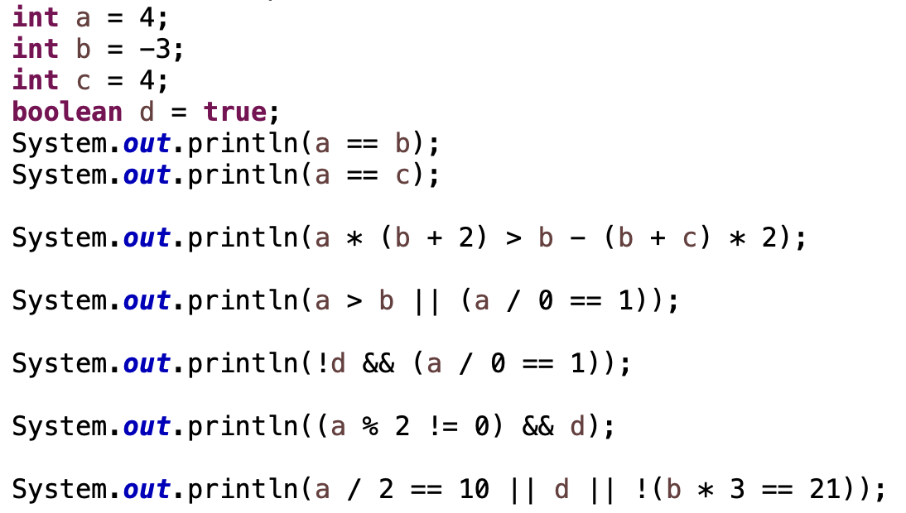
In-Class Practice
#1

Slide 29
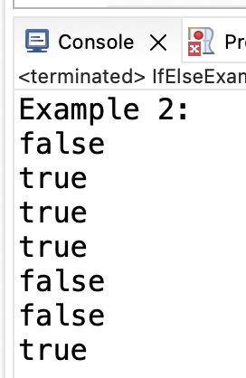
Solution

Slide 30
Short-Circuit Evaluation
Java stops evaluating a test if it knows the answer.
&& stops early if any part of the test is false
|| stops early if any part of the test is true
The following test will crash if s2's length is less than 2:
// Returns true if s1 and s2 end with the same two letters.
public static boolean rhyme(String s1, String s2) {
return s1.endsWith(s2.substring(s2.length() - 2)) &&
s1.length() >= 2 && s2.length() >= 2;
}
The following test will not crash; it stops if length < 2:
// Returns true if s1 and s2 end with the same two letters.
public static boolean rhyme(String s1, String s2) {
return s1.length() >= 2 && s2.length() >= 2 &&
s1.endsWith(s2.substring(s2.length() - 2));
}

Slide 31
Truth Tables
truth table: a table showing possible outcomes for boolean expressions
&&
p | q | Result
true | true | true
true | false | false
false | true | false
false | false | false
||
p | q | Result
true | true | true
true | false | true
false | true | true
false | false | false
!
p | Result
true | false
false | true
‹#›
Notes:
Note that == tests equality, not = . The = is used for the assignment operator!

Slide 32
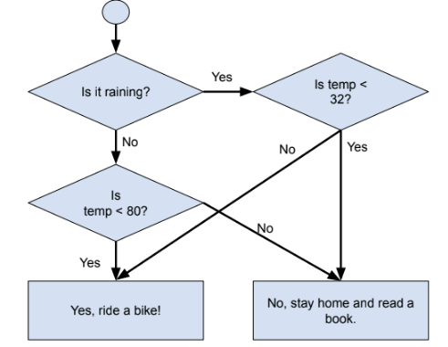
In-Class Practice
#2
rain | temperature |  |  | ride bike?
 | cold | moderate | hot
true | true | false | false
true | false | true | false
true
false
false
false

Slide 33
Solution
rain | temperature |  |  | ride bike?
 | cold | moderate | hot
true
true
true
false
false
false
rain | temperature |  |  | ride bike?
 | cold | moderate | hot
true | true | false | false
true | false | true | false
true | false | false | true
false | true | false | false
false | false | true | false
false | false | false | true
rain | temperature |  |  | ride bike?
 | cold | moderate | hot
true | true | false | false | false
true | false | true | false | true
true | false | false | true | true
false | true | false | false | true
false | false | true | false | true
false | false | false | true | false

Slide 34
Write a method named getRideBike() that accepts two parameters: boolean raining and int temp. Return true if the conditions indicate a bike ride is a good idea, false otherwise.
In-Class Practice
#3
rain | temperature |  |  | ride bike?
 | cold | moderate | hot
true
true
true
false
false
false
rain | temperature |  |  | ride bike?
 | cold | moderate | hot
true | true | false | false
true | false | true | false
true | false | false | true
false | true | false | false
false | false | true | false
false | false | false | true
rain | temperature |  |  | ride bike?
 | cold | moderate | hot
true | true | false | false | false
true | false | true | false | true
true | false | false | true | true
false | true | false | false | true
false | false | true | false | true
false | false | false | true | false

Slide 35
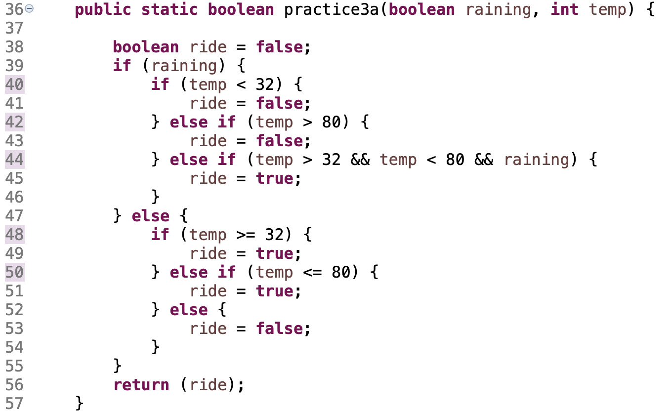
Possible Solution
This works.
Notice nested if/elses.
How could it be better?

Slide 36
Solution 2
Easier to read.
More efficient.
Focus on outcomes first.

Slide 37
Demo
Demo3()
Object Equality

Slide 38
Math.random() for Integers
To get a random number in a range from 1 - 10:
# | Step | Min | Max | Example
1 | Math.random() | 0.0 | .9999… | .7865…
2 | Multiple Math.random() by the range. The range is the number of possible integer outcomes. The range 20-49 has 30 outcomes. Math.random()* 10 | 0.0 | 9.9999… | 7.865…
3 | Add the first number in the range to shift from 0. Math.random()* 10 + 1 | 1.0 | 10.9999… | 8.865…
4 | Cast to an int. (int)(Math.random()* 10 + 1) | 1 | 10 | 8

Slide 39
Math.random() for Doubles
To get a random number in a range from 1.5 - 4.0:
# | Step | Min | Max | Example
1 | Math.random() | 0.0 | 0.9999… | .3472…
2 | Multiple Math.random() by the range. Math.random()* 2.5 | 0.0 | 2.4999… | .868…
3 | Add the first number in the range to shift from 0. Math.random()* 2.5 + 1.5 | 1.5 | 3.9999… | 2.368…
4 | Round to 1 decimal place. Math.round(number * 10) * 2.5 + 1.5 number = number/10; | 1.5 | 4.0 | 2.4

Slide 40
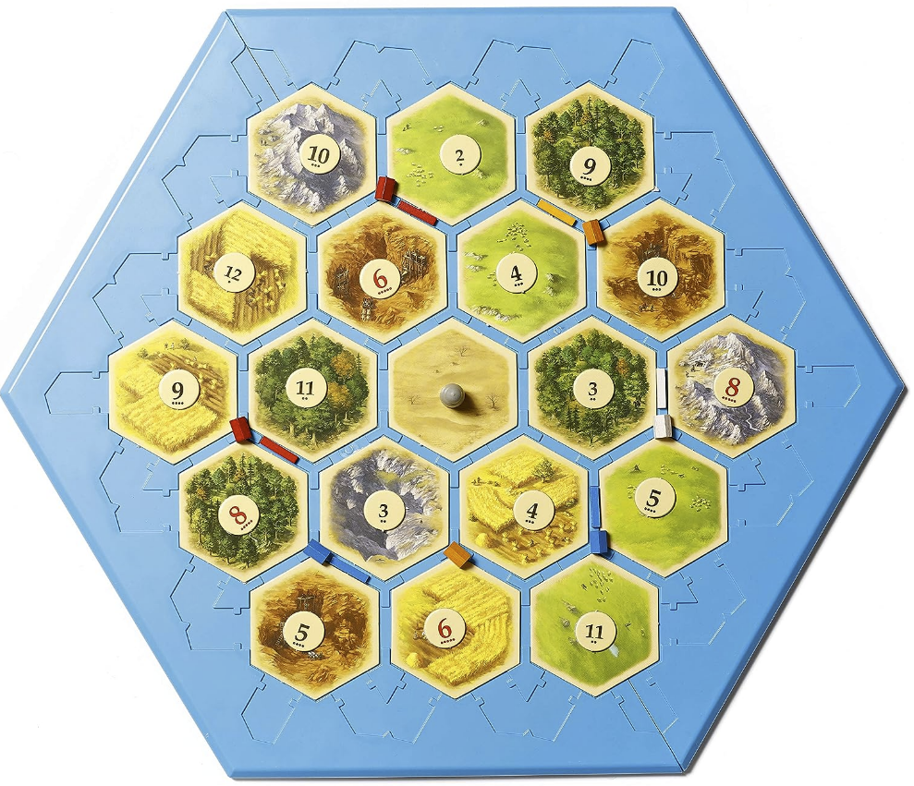
Settlers of Catan Board Placement

Slide 41
In-Class Practice
Given the main method above, write the rolls() method.
Purpose: Simulate rolling two die a given number of times, and counting the number of times a given outcome (2..12) occurs.
Parameters: int for number of rolls, int for number 2..12
Return: the number of times the 2..12 was rolled

Slide 42
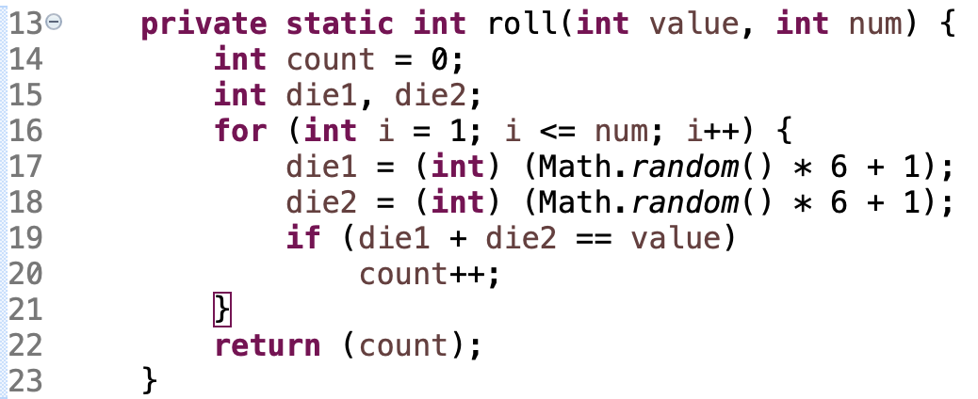
Solution

Slide 43
Monday CS Tip
TBD
Person

Slide 44
Remember
You Belong Here
Square Cap Returns!
Hi!

Slide 45
Blueprint - If-Else
Keyword if
Boolean expression in parenthesis
Body of code to be executed when true
Keywords else if to test second condition
Keyword else by itself, this body of code will be executed if the other conditions were false.
In a chain of if elses, as soon as one is true, execution leaves the entire if statement. Only one body of code will be executed. If there is no else, 0 or 1 body of code will be executed.

Slide 46
Blueprint - Scanner
Import the Scanner class.
Create a new Scanner.
Accept input from the user.
Close the Scanner.

